Slide 1


GLS, GMM, SUR, MLE
Muhammad Akmal Farouqi
13/3/2024
www.ugm.ac.id
Locally Rooted, Globally Respected

Slide 2

Generalized Least Square
Traditional OLS model requires to fulfil homoskedasticity assumption. In reality, we often face heteroskedasticity and serial correlation. This issue occurs when the residual covariance is inconsistent over observations. in some cases, it is unknown!
Thus, GLS method able to gives weight to the model so it can fulfil assumptions
Library(nlme)
gls(price~intst + age + agesq + nearinc, weights=varPower(), data = inc)
The assumption of
Doesn’t hold!

Slide 3

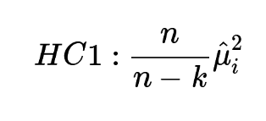
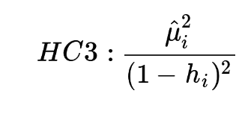
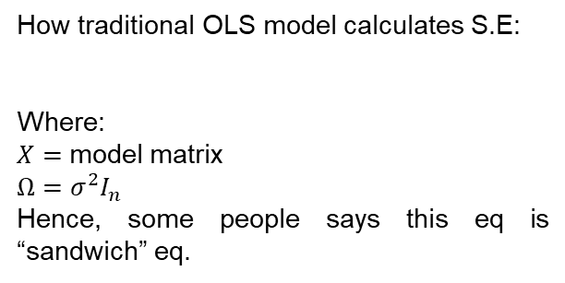
“Robust” Standard Error Regression
A regression estimator is said to be robust if it is still reliable in the presence of outliers. On the other hand, its standard error is said to be robust if it is still reliable when the regression errors are autocorrelated and/or heteroskedastic (Croux et al., NA). “Robust” standard errors is a technique to obtain unbiased standard errors of OLS coefficients under heteroscedasticity.
How traditional OLS model calculates S.E:
Where:
$X=$ model matrix
$Ω=σ^{2}I_{n}$
Hence, some people says this eq is “sandwich” eq.
That’s why we need Robust standard error, to allow non-consistent variance in our model!
We can use HC1 (heteroskesdasticity-consistent) approach:
Or HC 3:
The problem occurred when the estimated variance is not consistent and creating not accurate coefficients (and SE)

Slide 4
Seemingly Unrelated Regression
A seemingly unrelated regression (SUR) system comprises several individual relationships that are linked by the fact that their disturbances are correlated. Such models have found many applications. For example, demand functions can be estimated for different households (or household types) for a given commodity.
Library(systemfit)
fitsur <- systemfit(list(readreg = r1, mathreg = r2), method = "SUR", data=hsb2)
It can be used to tackle autocorrelation issue (like GLS).

Slide 5
Maximum Likelihood
maximum likelihood estimation (MLE) is a method of estimating the parameters of an assumed probability distribution, given some observed data. This is achieved by maximizing a likelihood function so that, under the assumed statistical model, the observed data is most probable. The point in the parameter space that maximizes the likelihood function is called the maximum likelihood estimate.
Unlike OLS, we can specify the distribution of our model’s residual/parameters manually. Of course it is a bit challenging because we must understand the nature of data generating process (DGP).
# Manual MLE
library(stats4)
# Define the model using the dnorm() function
LL <- function(beta_0, beta_1, sigma){
-sum(dnorm(Test_Score,(beta_0+beta_1*Teaching_Method), sigma, log = TRUE))
}
# use mle() function to calculate regression coefficients
result_1 <- mle(LL, start = list(beta_0 = 1, beta_1=1, sigma = 19))

Slide 6
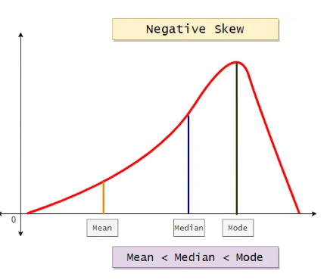
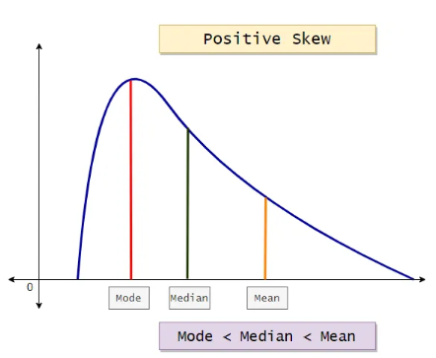
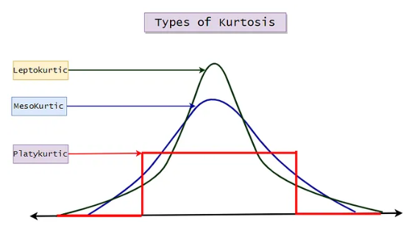
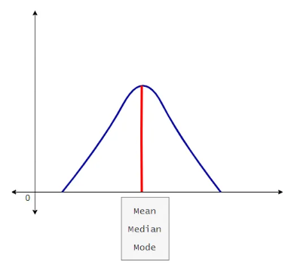
Generalized Method of Moment
In Statistics, Moments are popularly used to describe the characteristic of a distribution. Let’s say the random variable of our interest is X then, moments are defined as the X’s expected values.
For Example, E(X), E(X²), E(X³), E(X⁴),…, etc.
1) First Moment: Measure of the central location. | Mean, Median, Mode
2) Second Moment: Measure of dispersion/spread. | Variance, Standard Deviation
3) Third Moment: Measure of asymmetry. | Skewness
4) Fourth Moment: Measure of outliers/tailedness. | Kurtosis
Mesokurtic
These types of distributions are having the kurtosis of 3 or excess kurtosis of 0.
Leptokurtic
These types of distributions are having a kurtosis greater than 3, or excess kurtosis greater than 0.
Platykurtic
These types of distributions are having the kurtosis smaller than 3 or excess kurtosis less than 0(negative).
Skewness
Kurtosis

Slide 7
Generalized Method of Moment
For simplicity, GMM objectives is to optimize the model with respect to its decided moments. Unlike maximum likelihood estimation (MLE), GMM does not require complete knowledge of the distribution of the data. Only specified moments derived from an underlying model are needed for GMM estimation.
Library(gmm)
gmm_result <- gmm(moment_conditions, x = data, t0 = initial_values)

Slide 8
Thank You

